Slide 1


Stimulating artificial neurons with simplex and torus networks: an information-theoretic study
Jacob Bamberger

Slide 2
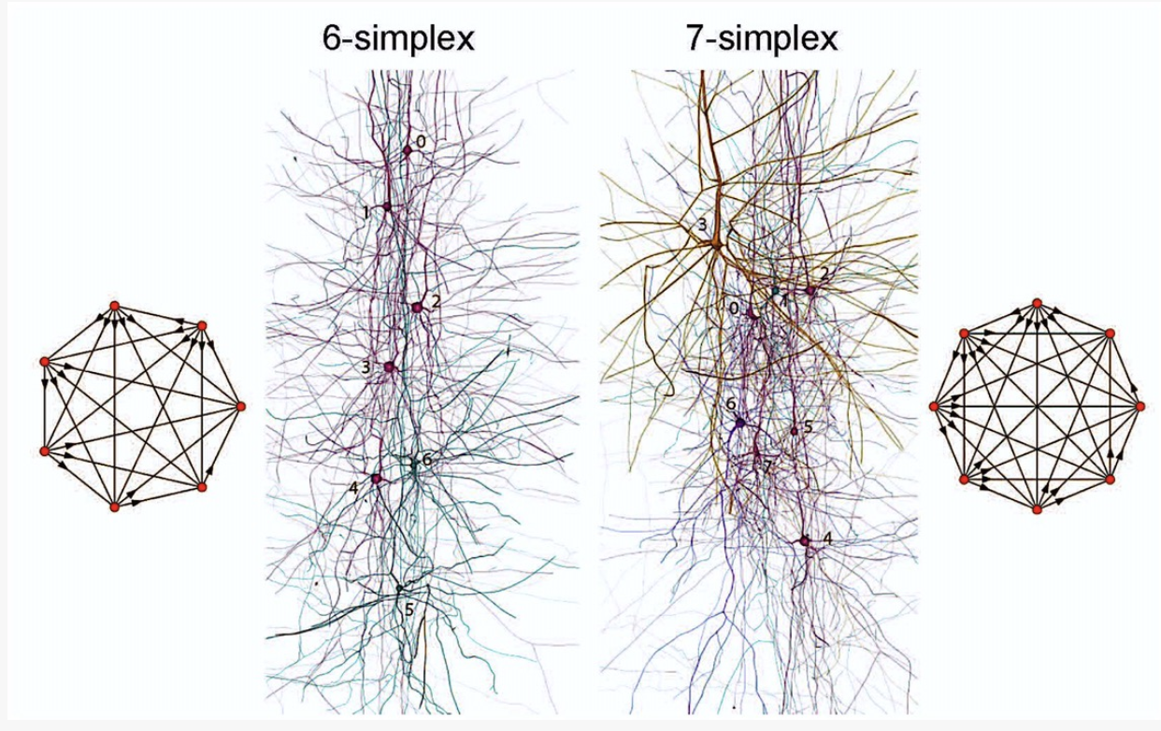
From Frontiers in Computational Neuroscience, ‘Cliques of Neurons Bound into Cavities Provide a Missing Link between Structure and Function’.
(Reimann et al. 2017)

Slide 3
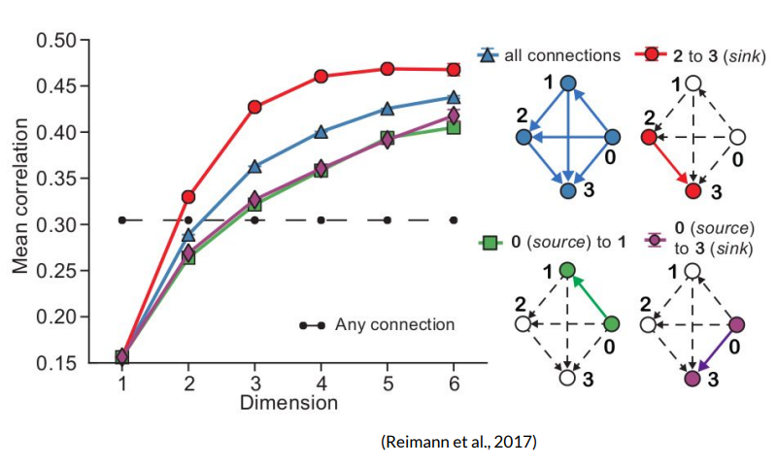
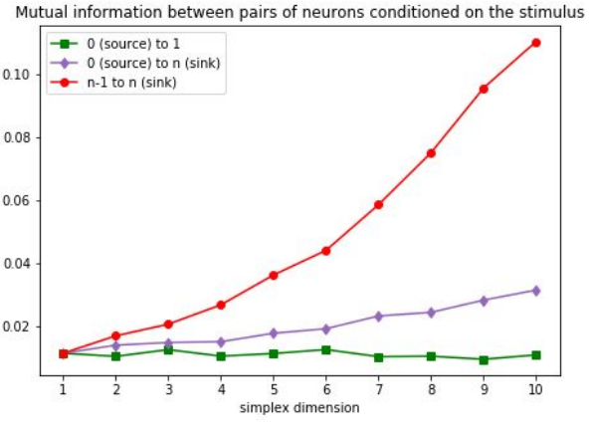
Link between Structure and Function
“We found a remarkably high number and variety of high-dimensional directed cliques and cavities.”
“Pairwise correlations in neuronal activity increased with the number and dimension of the directed cliques to which a pair of neurons belongs.”
Reimann et al. (2017)
In Frontiers in Computational Neuroscience
Tools from information theory allows for a closer study of the link between structure and function.
Skander Moalla

Slide 4
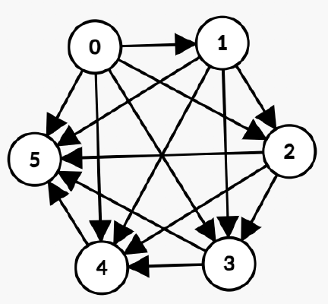
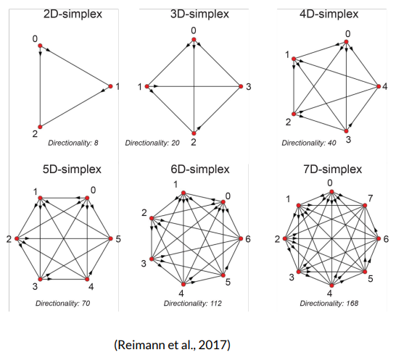
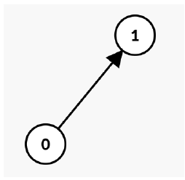
What has been done
Parent Network
All to all
Connected
Children
Network

Slide 5
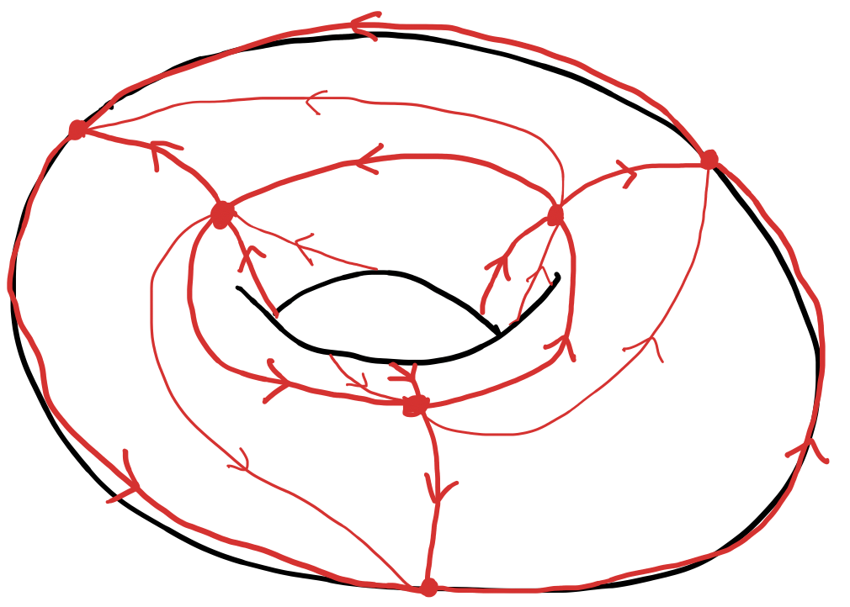
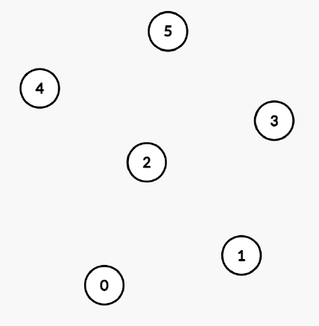
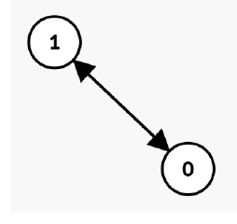
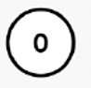
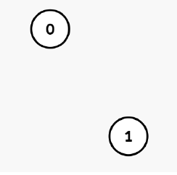
Our Experiment
Parent Network
All to all
Connected
Children
Network

Slide 6
Graphs and
Topology
Dynamical Systems
Artificial neural network
Brian2 Package
Distributions & Information Theory
Raster plots

Slide 7
Graphs and
Topology
Dynamical Systems
Artificial neural network
Brian2 Package
Distributions & Information Theory
Raster plots

Slide 8

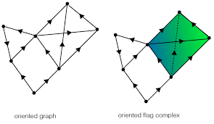
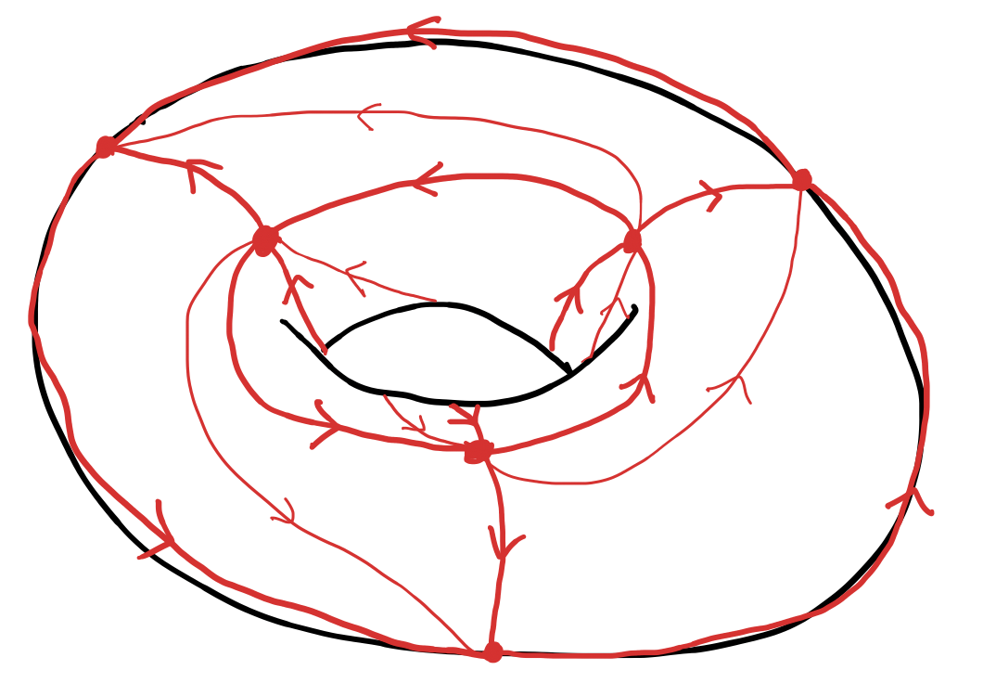
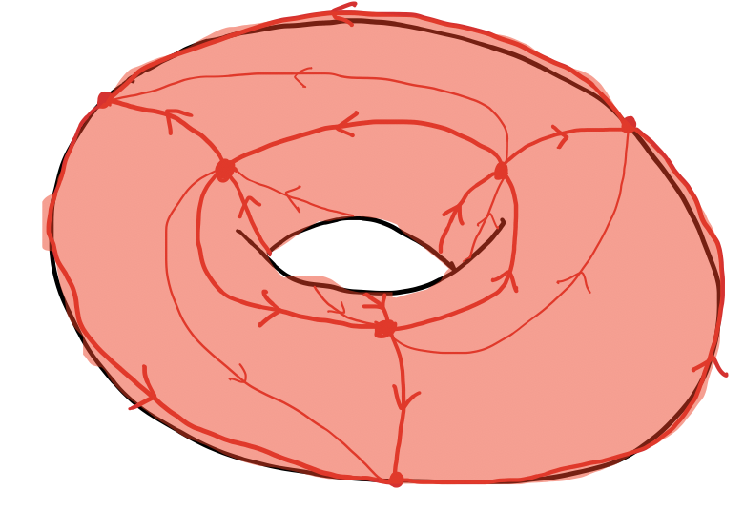
From directed graphs to combinatorial topology
Structure
Pawel Dlotko
‘Directed complexes’

Slide 9
|V| = n
β₀ = n
β_{i} = 0
𝝌 = n
dim = 0
|V| = n
β₀ = 1
β₁ = 2
β₂ = 1
𝝌 = 1
dim = 2
Disconnected
Triangulated Torus
|V| = n
β₀ = 1
β_{i} = 0
𝝌 = 1
dim = n-1
|V| = n
β₀ = 1
dim = n-1
Simplex
Fully connected

Slide 10
Graphs and
Topology
Dynamical Systems
Artificial neural network
Brian2 Package
Distributions & Information Theory
Raster plots

Slide 11
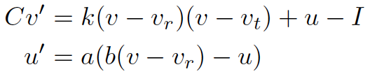
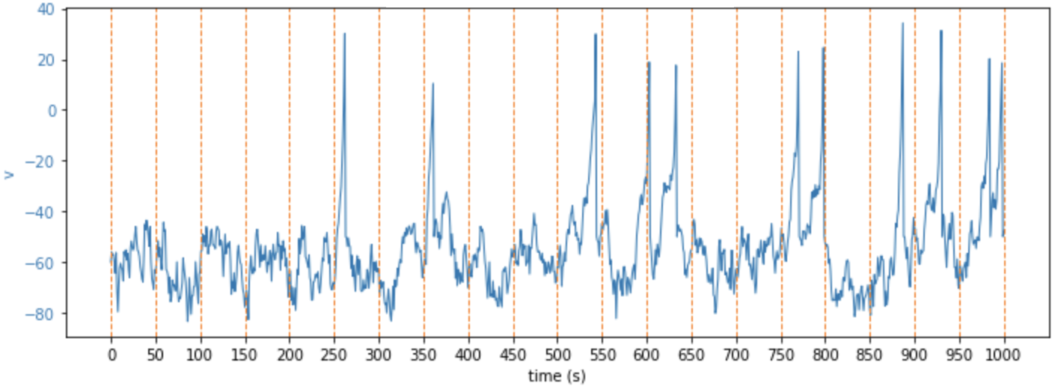
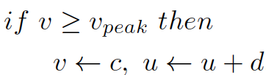
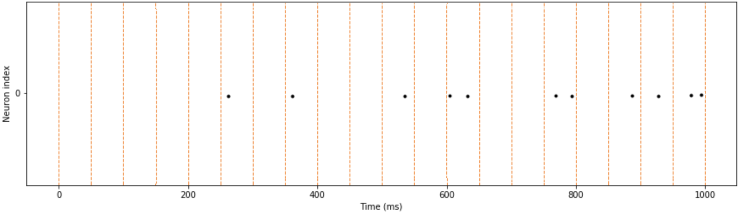
Neural network model
v represents the membrane potential
u represents membrane recovery
I represents input stimulus
Reset:
Neuron
Simple Model of Choice
(Izhikevich, 2003)
Instantaneous change in the membrane potential of the post-synaptic neuron.
v ← v + w
w is the synapse weight
I = x
x is a Gaussian random variable
Noise
Synapse

Slide 12
Graphs and
Topology
Dynamical Systems
Artificial neural network
Brian2 Package
Distributions & Information Theory
Raster plots

Slide 13
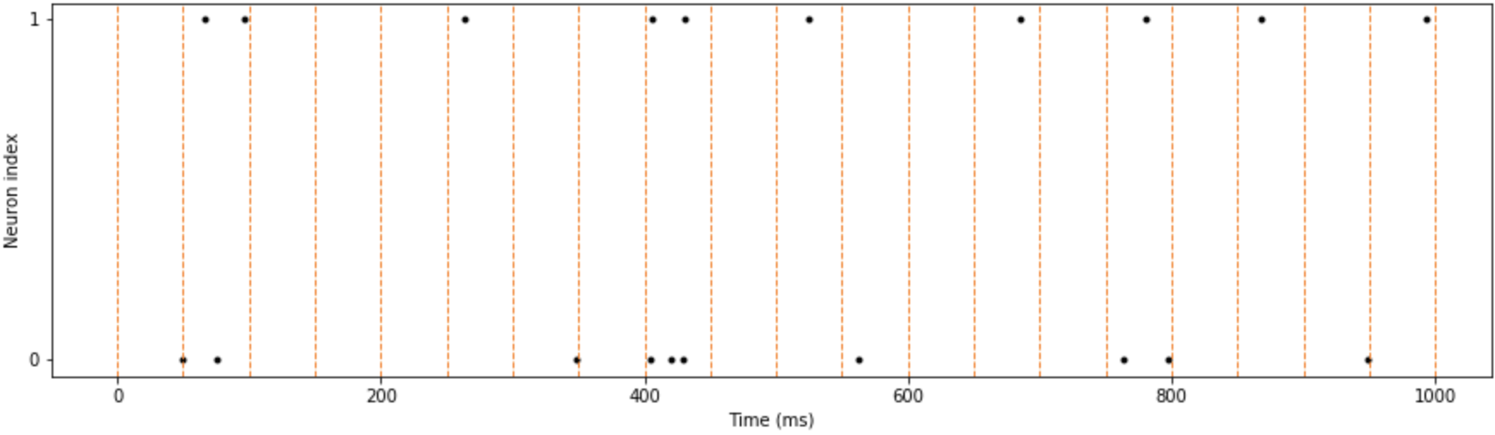

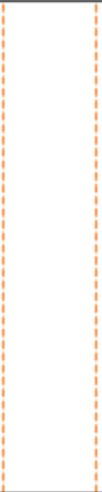




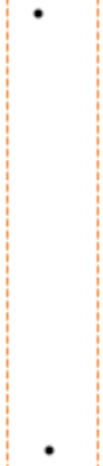

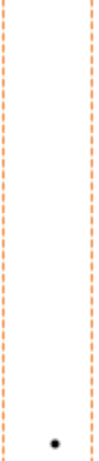
Probabilistic Modelling
Time bin 7 of each simulation:
For each time bin, we get a random vector (N₀, N₁, …, N_{n}) with joint distribution
p_{(N0, N1, …, Nn)}
N₁
N₀
Sim 1
Sim 2
Sim 3
Sim 4
Sim 5
 | 0 | 1 | 2
0 | 0.3 | 0.2 | 0
1 | 0.1 | 0.2 | 0.1
2 | 0 | 0.1 | 0
N₀
N₁
N₁
N₀
Sim 6
Sim 7
Sim 8
Sim 9
Sim 10
P(N₀= i, N₁= j)

Slide 14
Graphs and
Topology
Dynamical Systems
Artificial neural network
Brian2 Package
Distributions & Information Theory
Raster plots

Slide 15
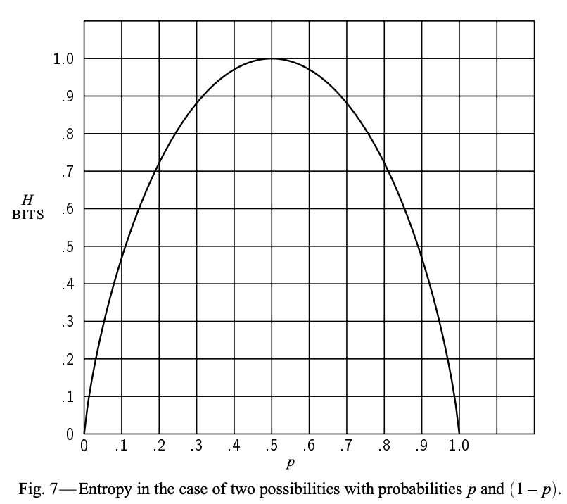
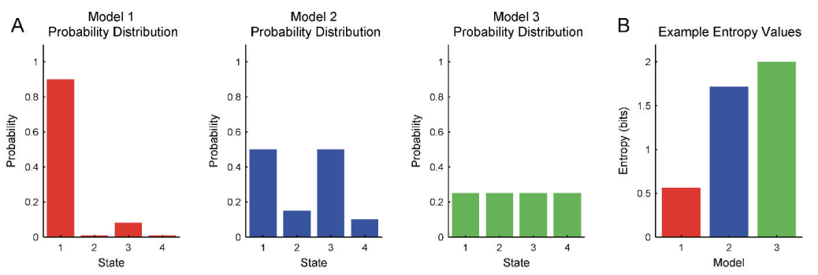
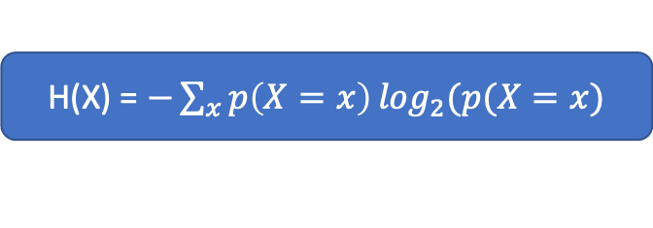
Entropy
(Shannon, 1948)
Models ‘randomness’
H(X) = $−\sum_{x}{p\left(X=x\right)⁡\log_{2}(p(X=x)}$
Maximized for X uniform
Multivariate! Replace X by (Y, Z)

Slide 16
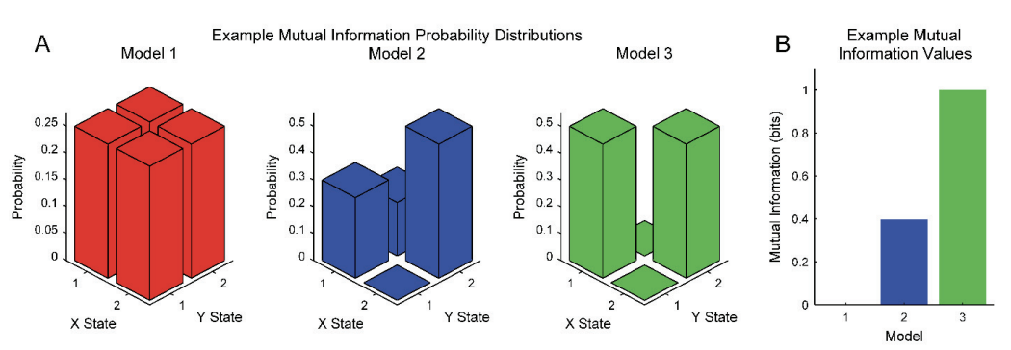
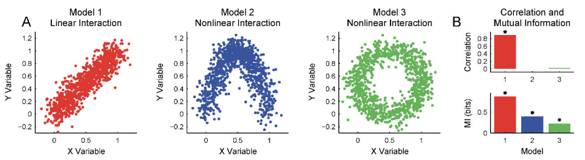
Mutual Information
Models shared ‘randomness’
I(X; Y) = H(X) + H(Y) – H(X, Y)
(Timme and Lapish, 2018)
Detects Nonlinear Interactions
(Wikipedia, Mutual Information)
(Wikipedia, Mutual Information)

Slide 17
Results

Slide 18
Impact of connections between two neurons
Disconnected
1-Simplex
‘Loop’
Network:
1.177
1.240
1.273
H(N₀)
2.352
2.501
2.408
H(N₀,N₁)
‘Information
Simplex’:
1.177
1.179
1.269
H(N₁)
0.001
0.012
0.041
Mutual information:

Slide 19
The Experiment
Parent Network
All to all
Connected
Children
Network

Slide 20
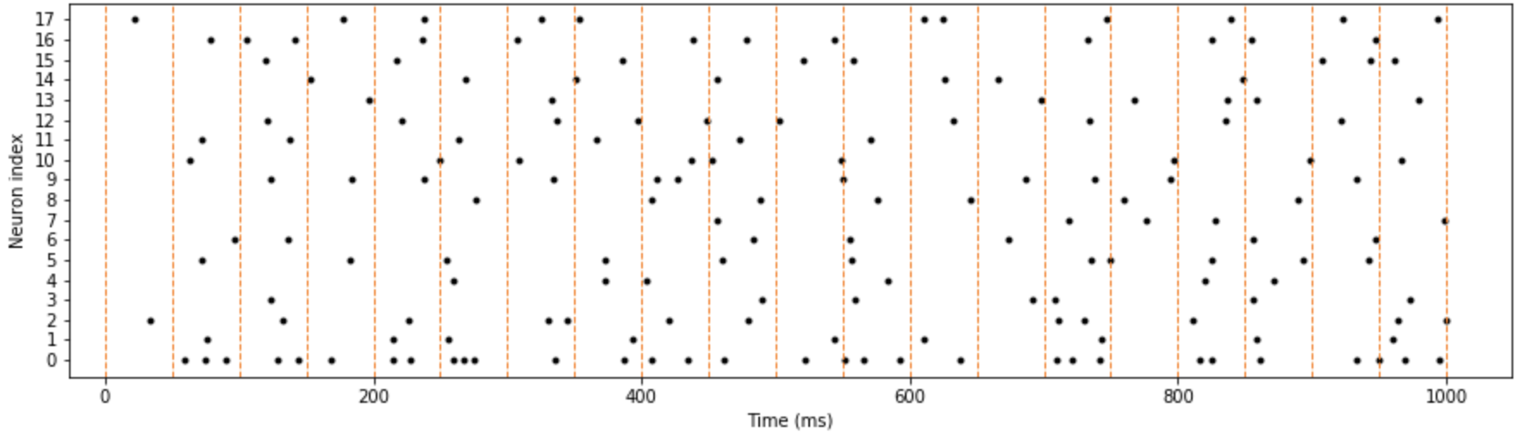
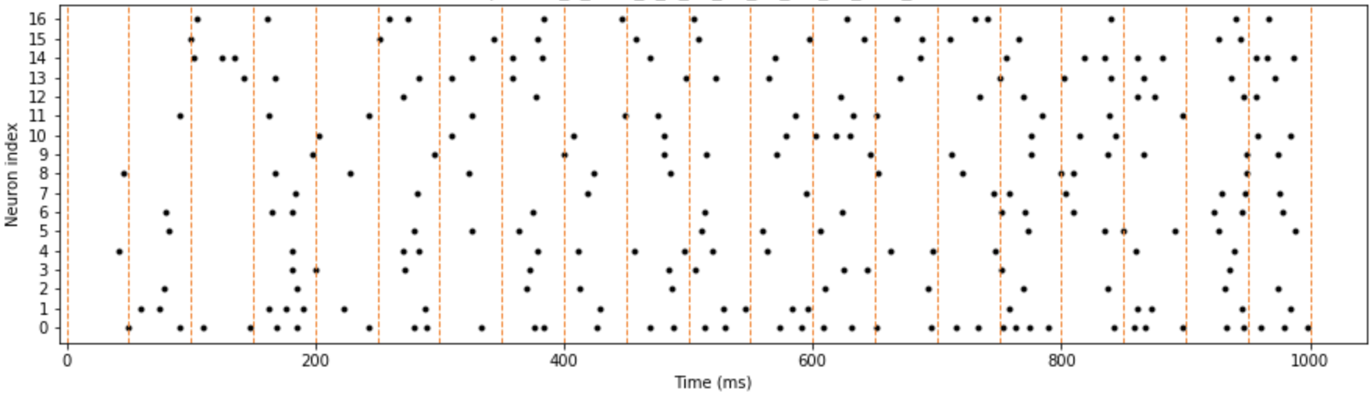
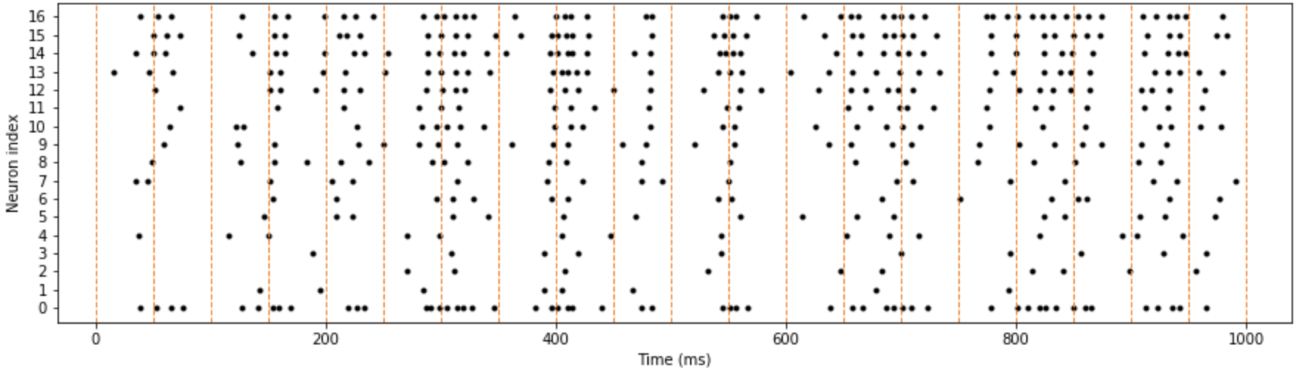
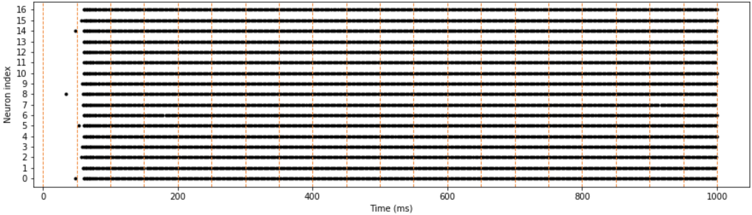
One child
Disconnected
Torus
Simplex
Full

Slide 21
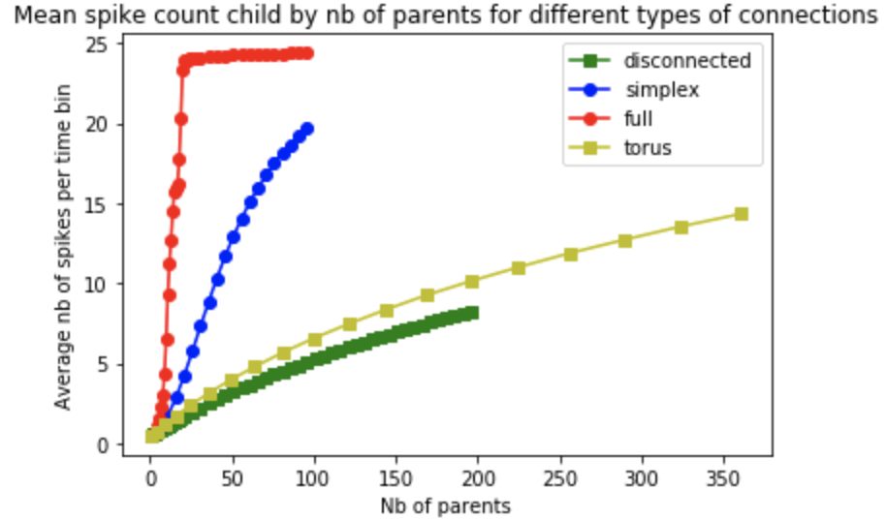
Entropy and Number of Parents
Entropy increases with number of parents
The topology of the network impacts the entropy

Slide 22
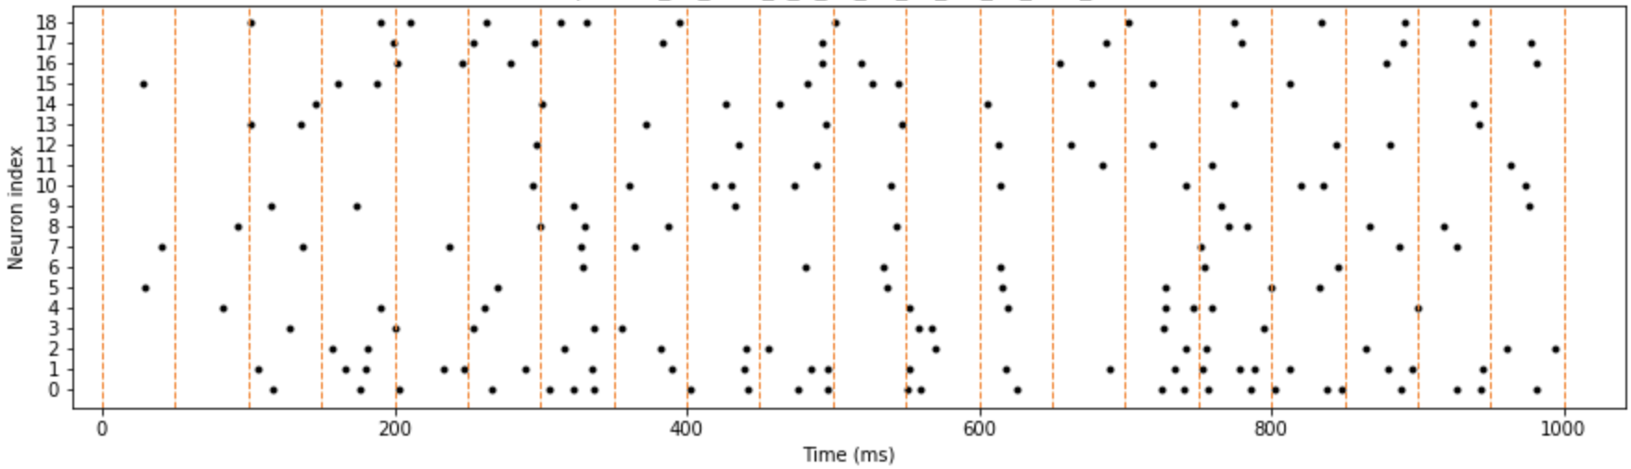
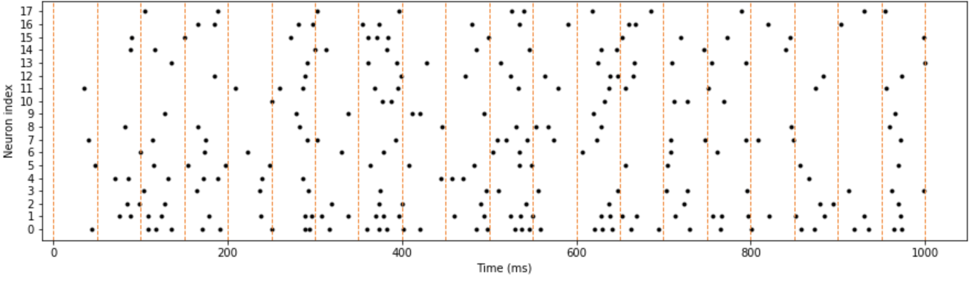
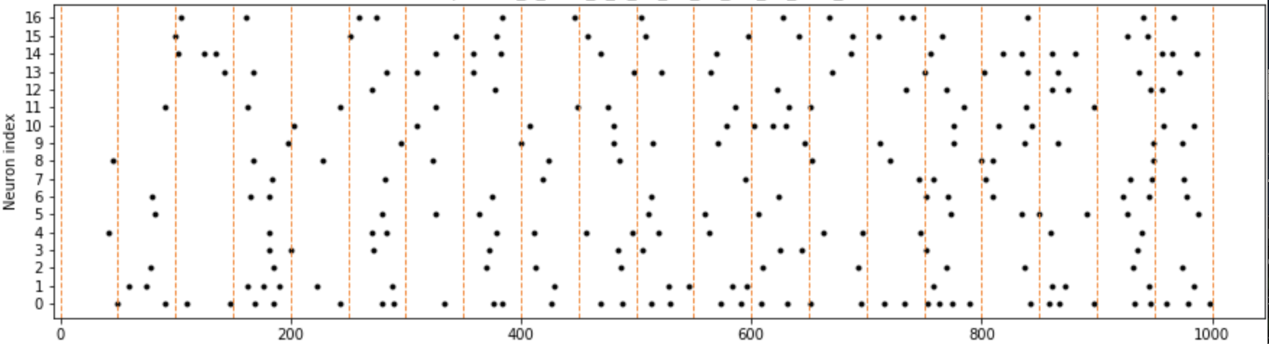
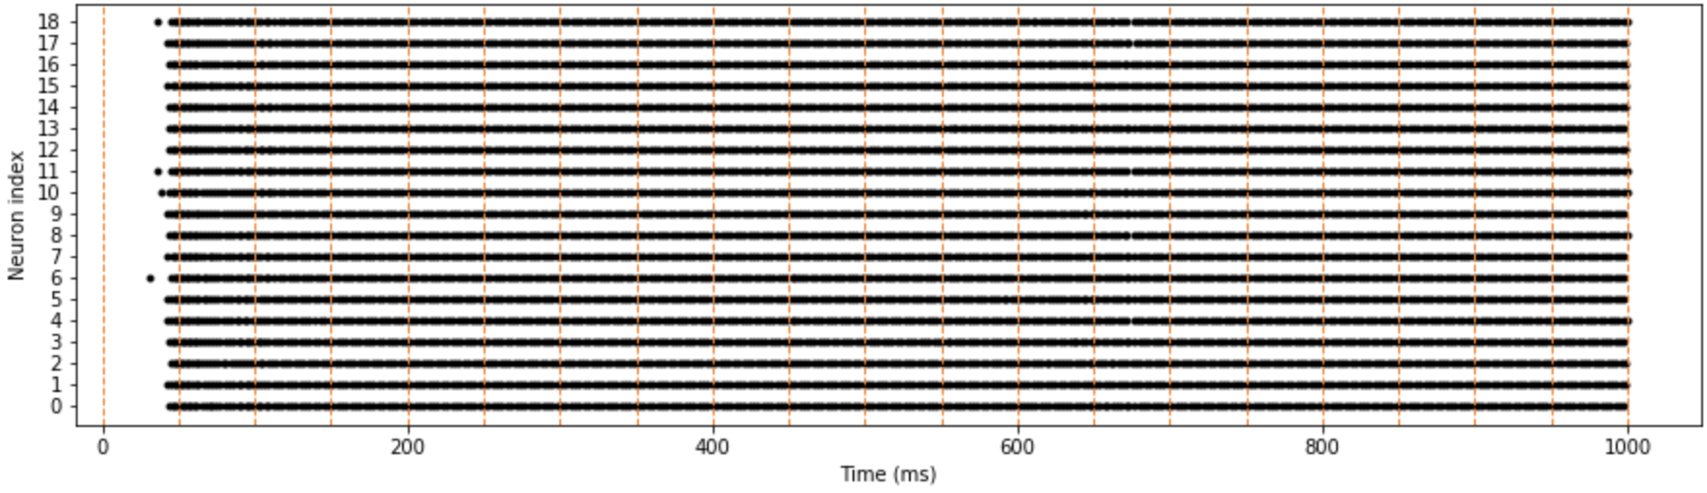
Two children
Disconnected
Torus
Simplex
Full

Slide 23
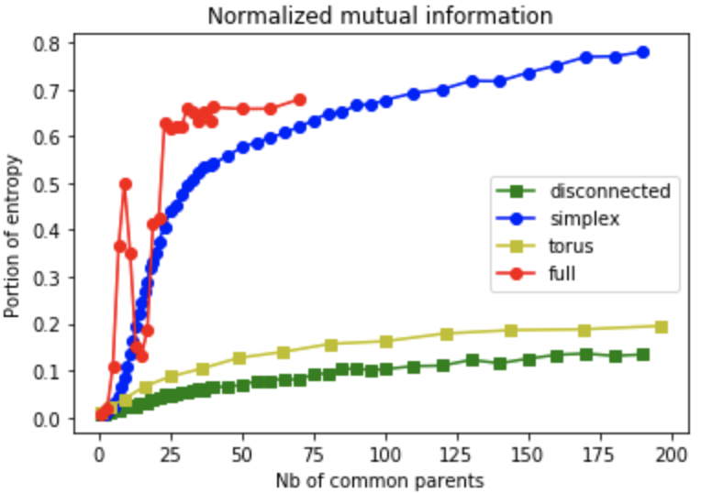
Mutual Information between two children and Number of Common Parents

Slide 24
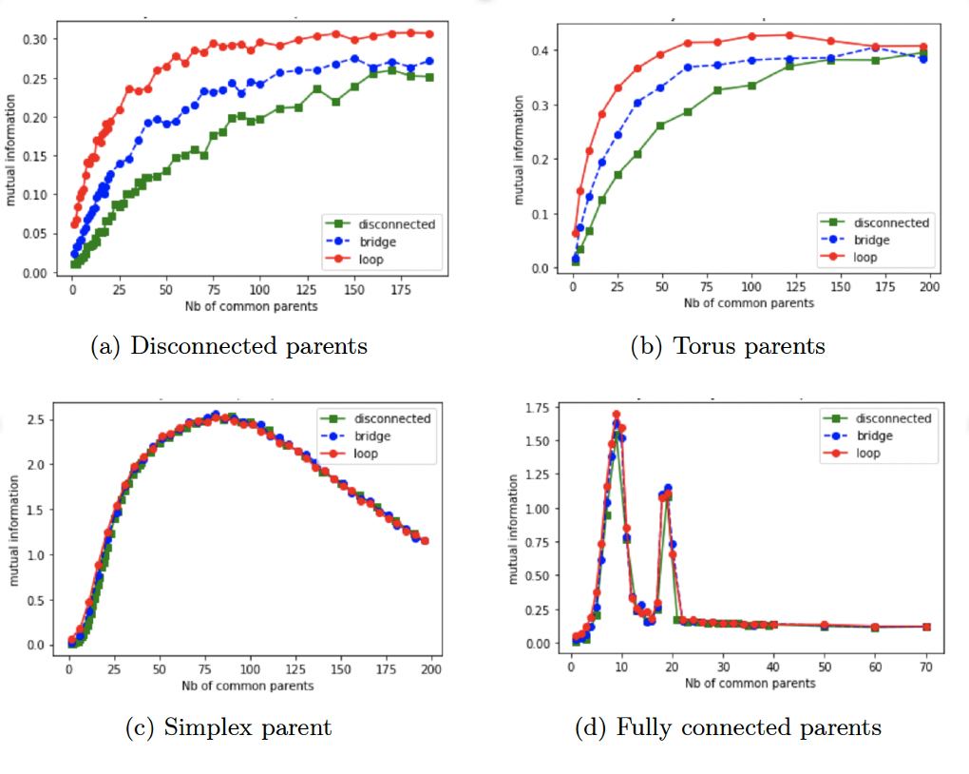
Mutual Information for different Children Connection

Slide 25
Conclusion
‘Randomness’ of a neuron increases with activity of parents
Similarity between two neurons reflects the common input they receive
High dimension in common parents is essential for similar activity!

Slide 26
Further Directions
More parent spaces!!
How to best transmit a given message?
Fix a Source S, a Receiver R, what is the optimal Channel C maximizing I(S, R)?
Source
Network
S
Receiver
Network
R
Channel Network
C
Fix a Channel C, what is the optimal (S, R) pair maximizing I(S, R)?
How to best make use of a given channel?
Neural Communication Channel

Slide 27
Thank you!

Slide 28
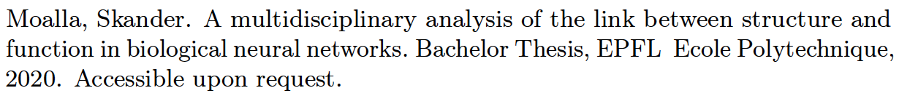
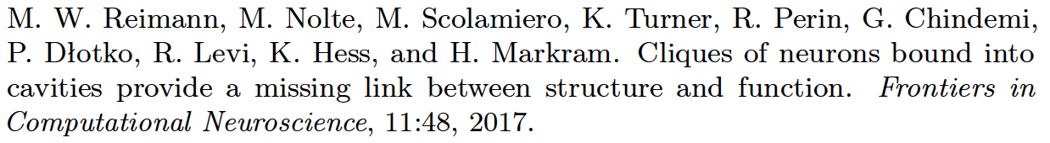
Bibliography
jdn
kjdn
jkd d

Slide 29
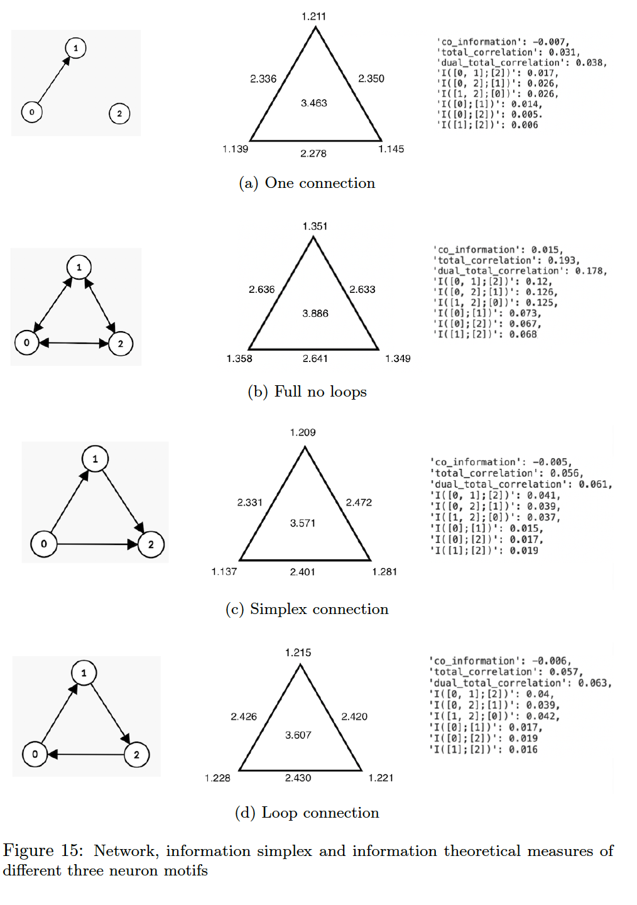

Slide 30
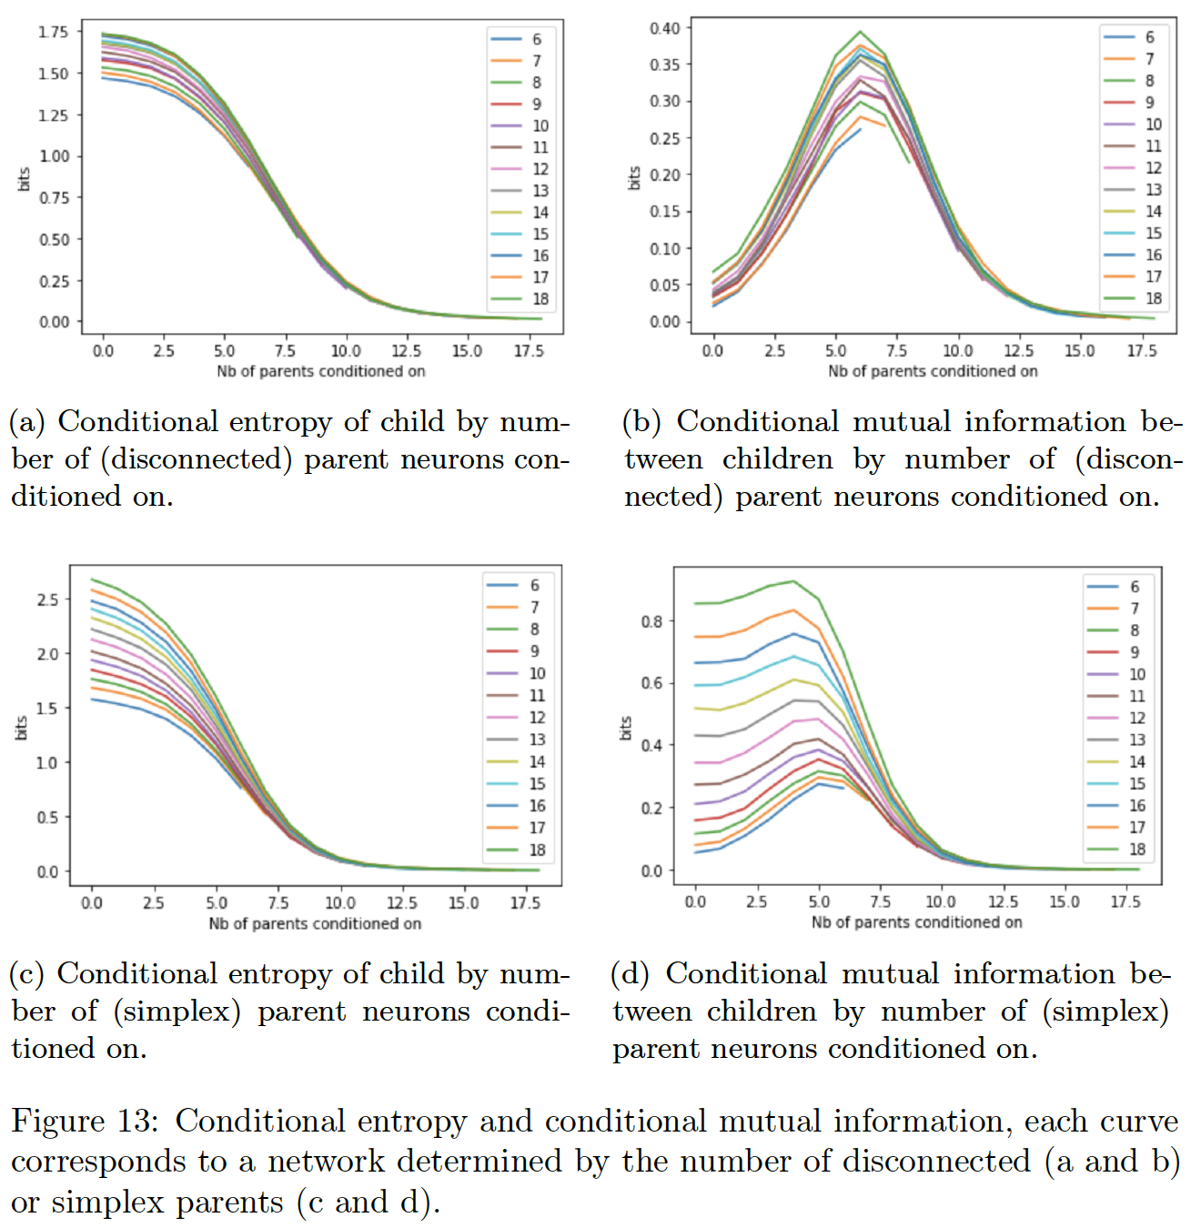

Slide 31
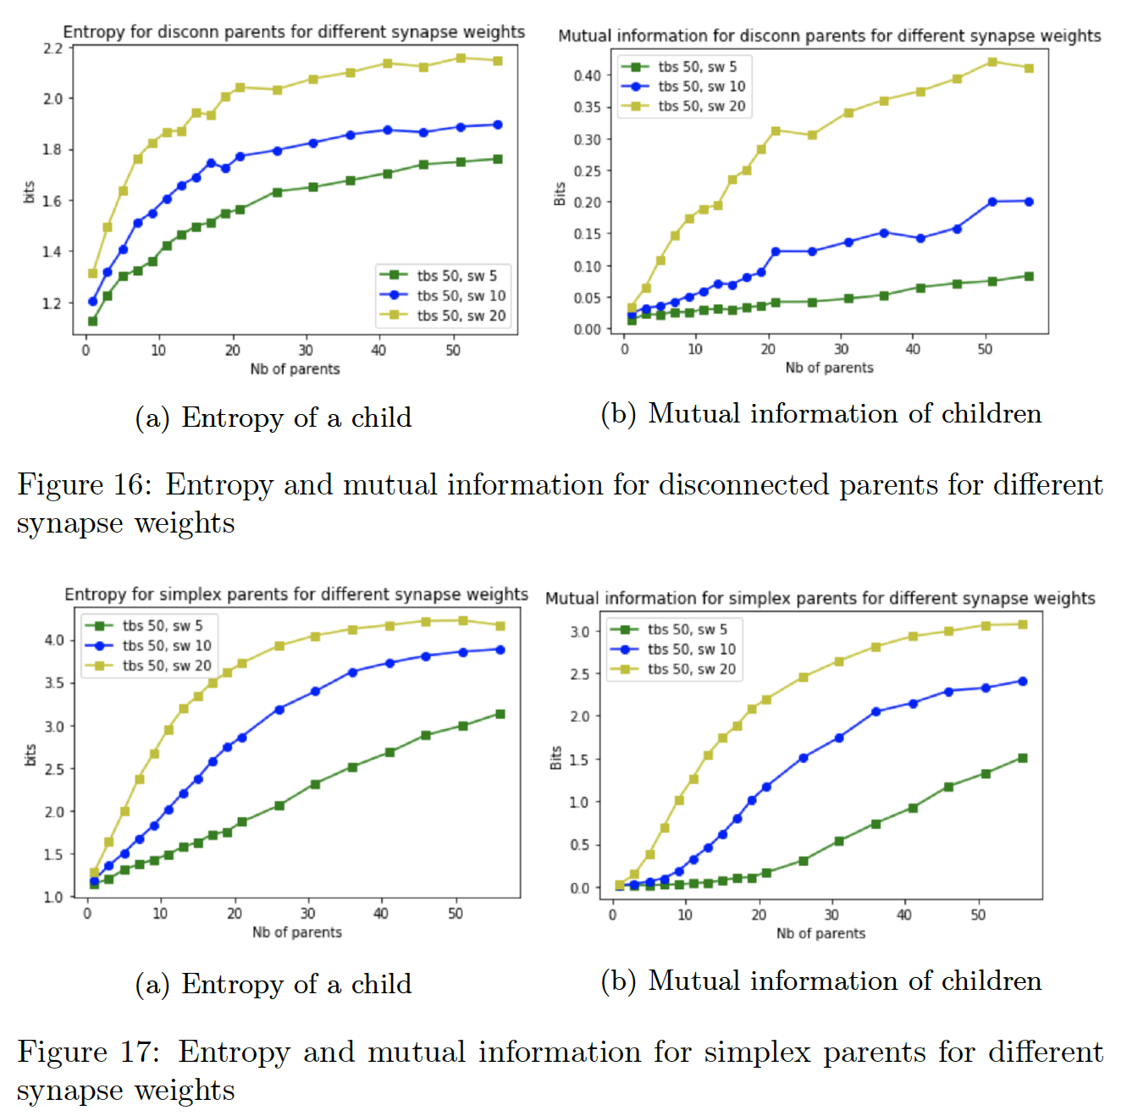

Slide 32
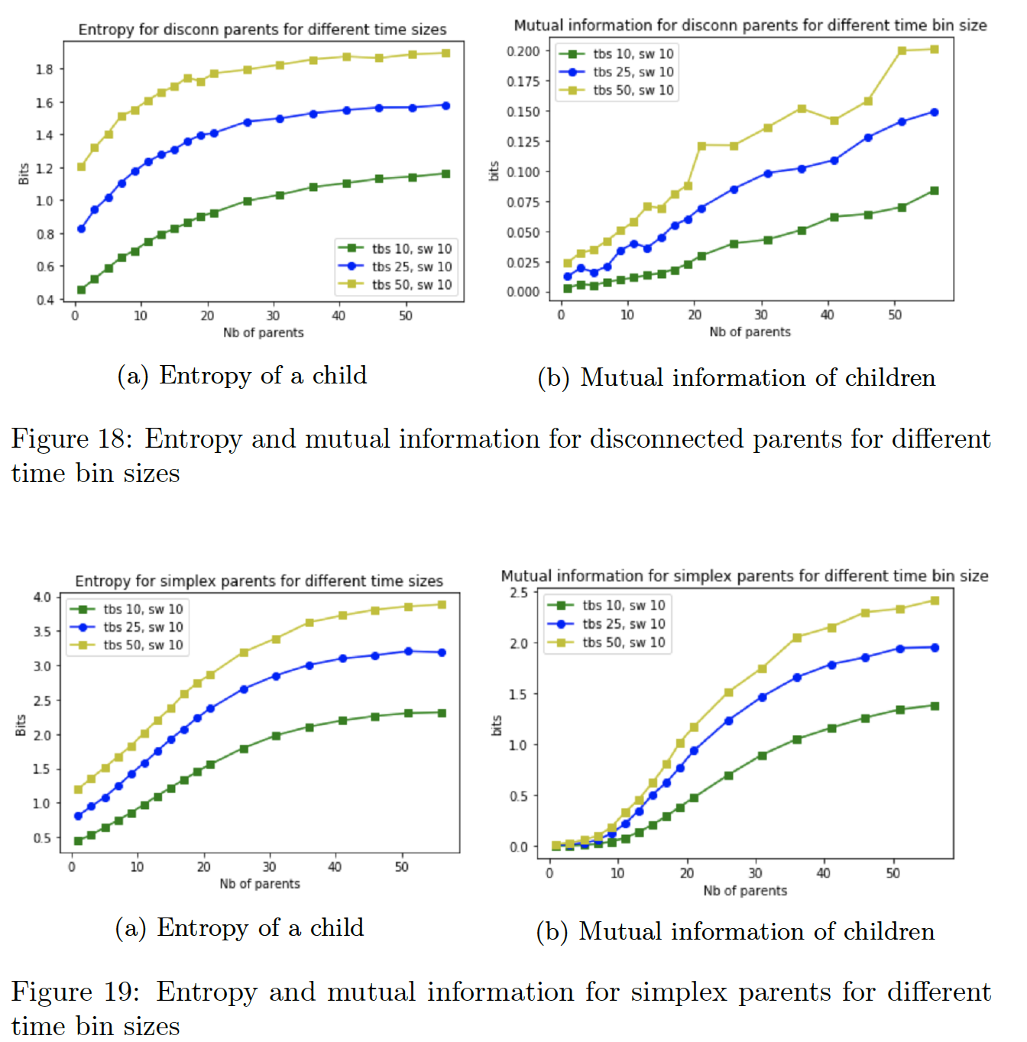

Slide 33
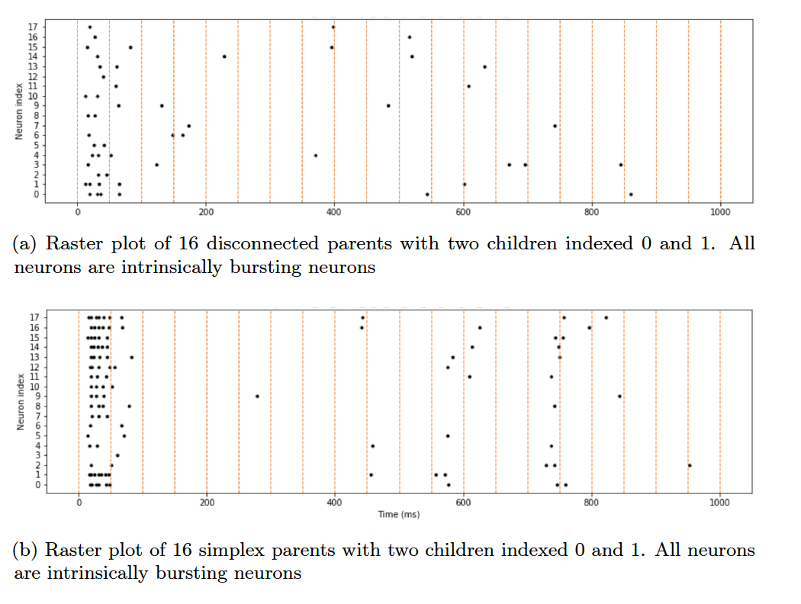
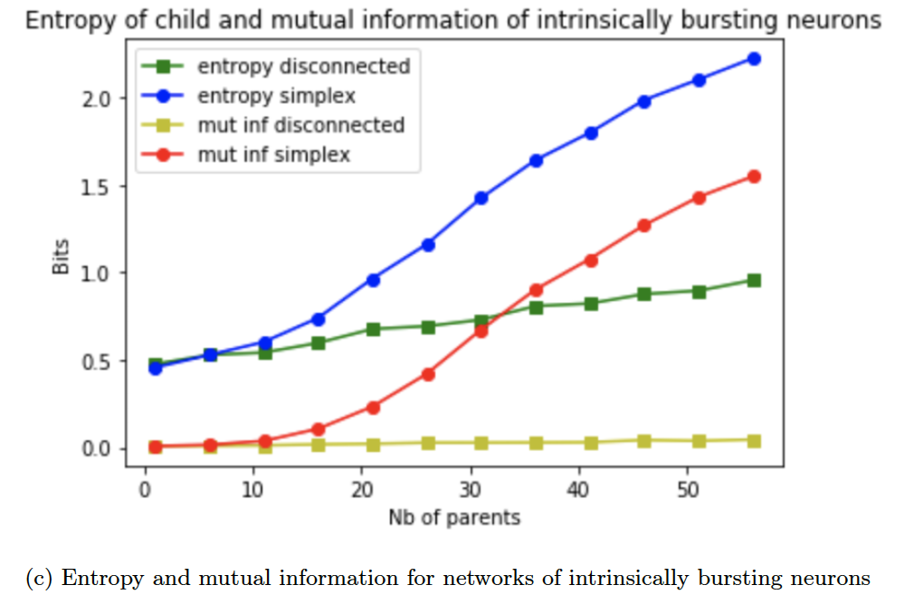
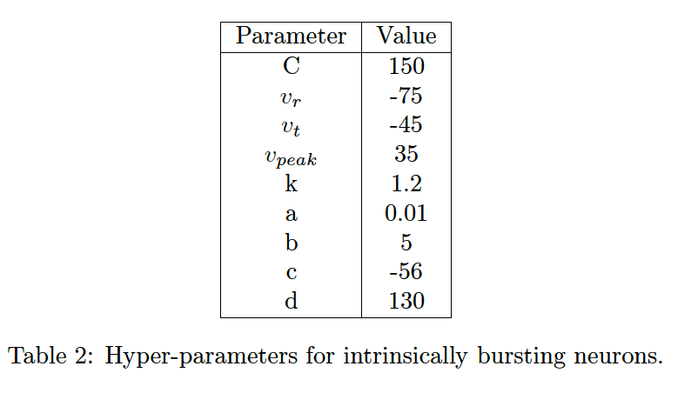

Slide 34
